Slide 1
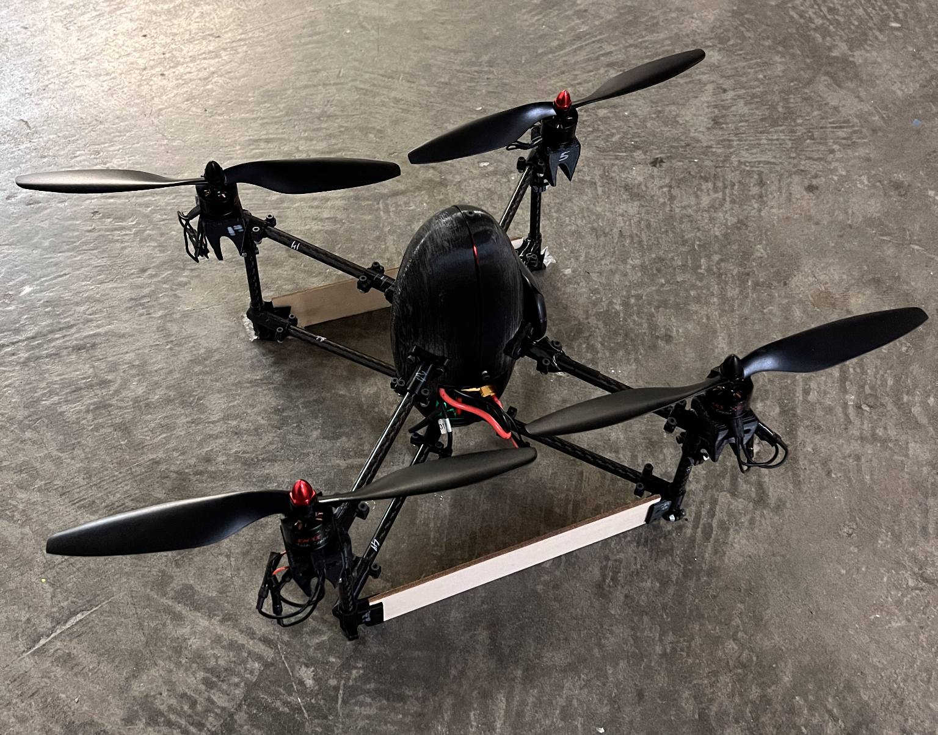
CRC-3 Build
Anton Kapitman, Jacob Charest, Trenton Squires| 04/27/2022

Slide 2
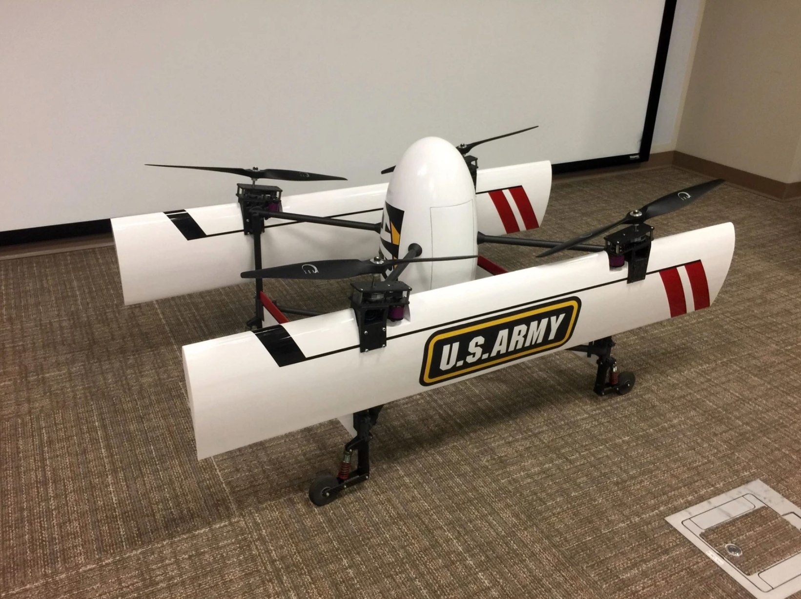
Introduction to the QRBP CRC-3
QRBP (Quadrotor Biplane)
VTOL, Hover, and Fixed-Wing Forward Flight
CRC-3 (Common Research Configuration - 3lbs)
Army Research Lab Version

Slide 3
Motivation and Goals
QRBP is an interesting concept, bringing rotary wings and fixed wings into one project
Benefits of QRBP: minimal landing and takeoff footprint, takes advantage of the best characteristics of fixed-wing and rotorcraft, more energy efficient and faster in forward flight
Goals: Build a fully functional CRC-3 QRBP for both flight modes controlled by a handheld controller. This will aid the research of autonomous control of the drone, specifically combining the two flight modes and their transitions into one controller.

Slide 4
Electronics Concept
Communication to Drone
Communication to Motors
Remote Control
3S Battery
Power Distribution Board
Connection to QGC (USB)
VOXL FLIGHT
Connection to QGC (WiFi card)
PWM Break Out Board
Electronic Speed Controllers
External GPS
Communication to Navigation
Motors

Slide 5
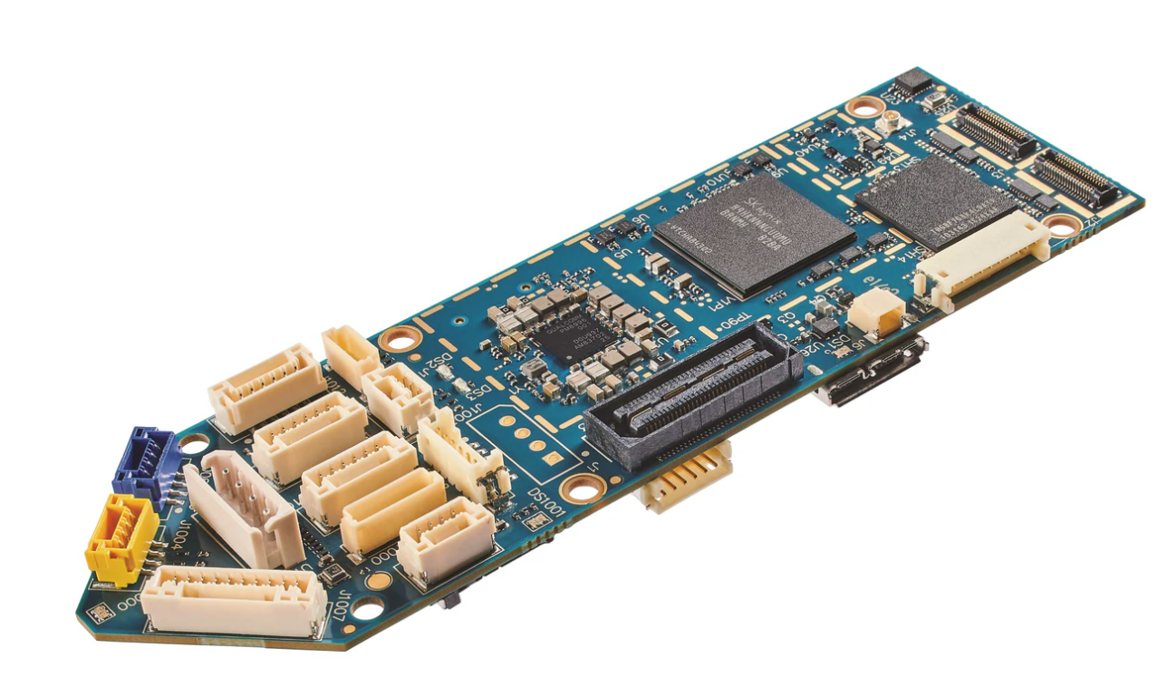
Electronic Component Selection
VOXL Flight
Open Source (ARL) PX4 Flight Core
VOXL - Qualcomm Snapdragon Companion Computer
Image sensors, time-synchronized IMU
I/O: WiFi, SPI, I2C, UART, GPIO

Slide 6
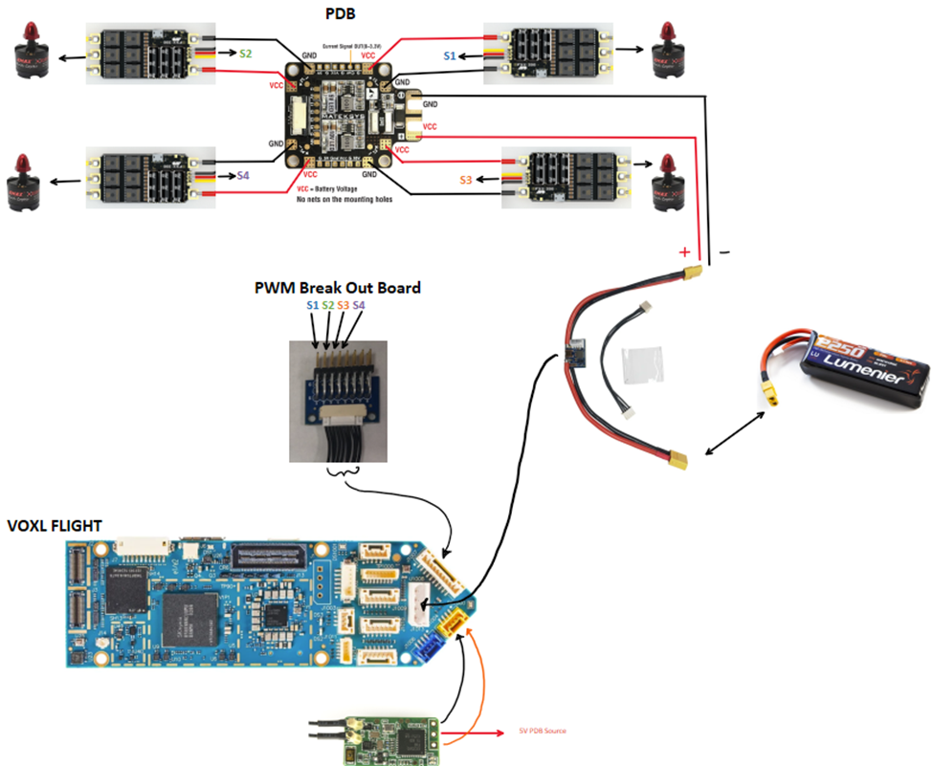
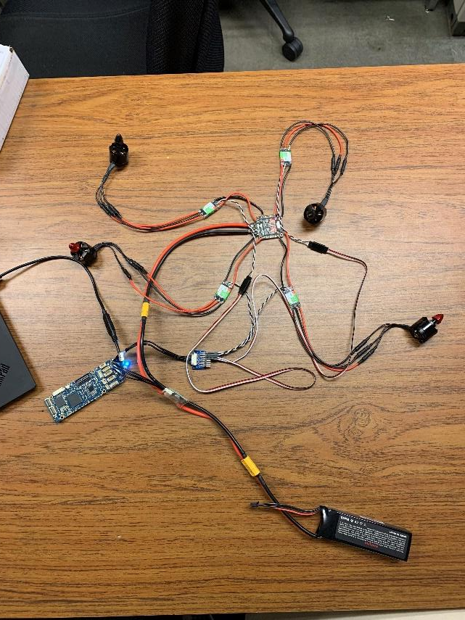
Circuitry
Starting point this semester for the electronics-QGC configuration

Slide 7
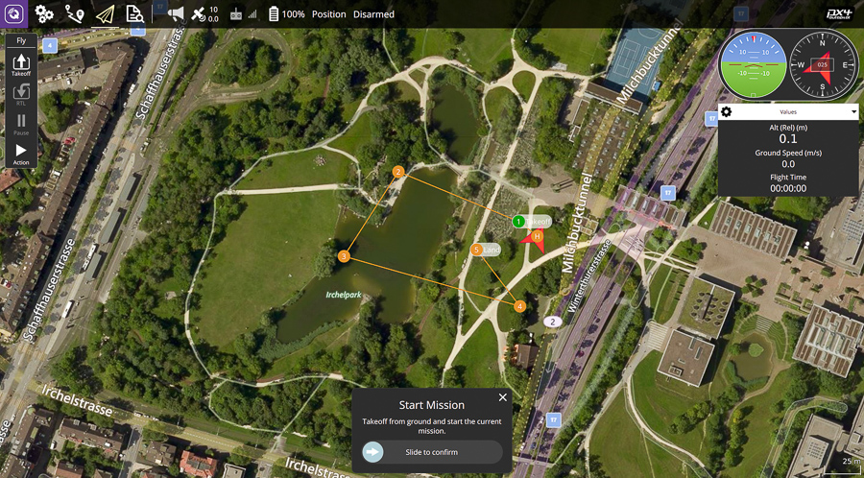

Control Station
QGroundControl (QGC)
Control Station for mission planning and flight
Supports PX4 powered vehicles
Displays vehicle position, speed, waypoints, compass, attitude, battery level
Mainly used for vehicle setup/configuration for this project

Slide 8
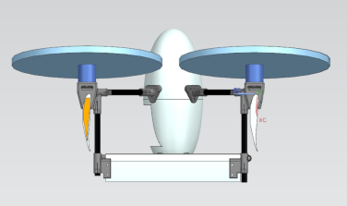
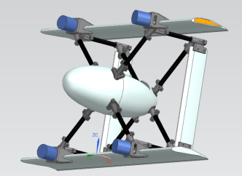
Starting Point

Slide 9
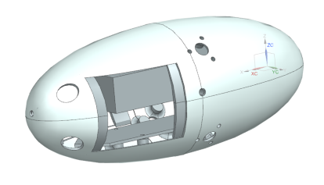
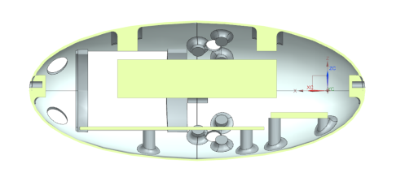
Body Redesign
Redesigning for a more favorable 3D printed body
Fitting the wiring, battery, flight board, and PDB

Slide 10
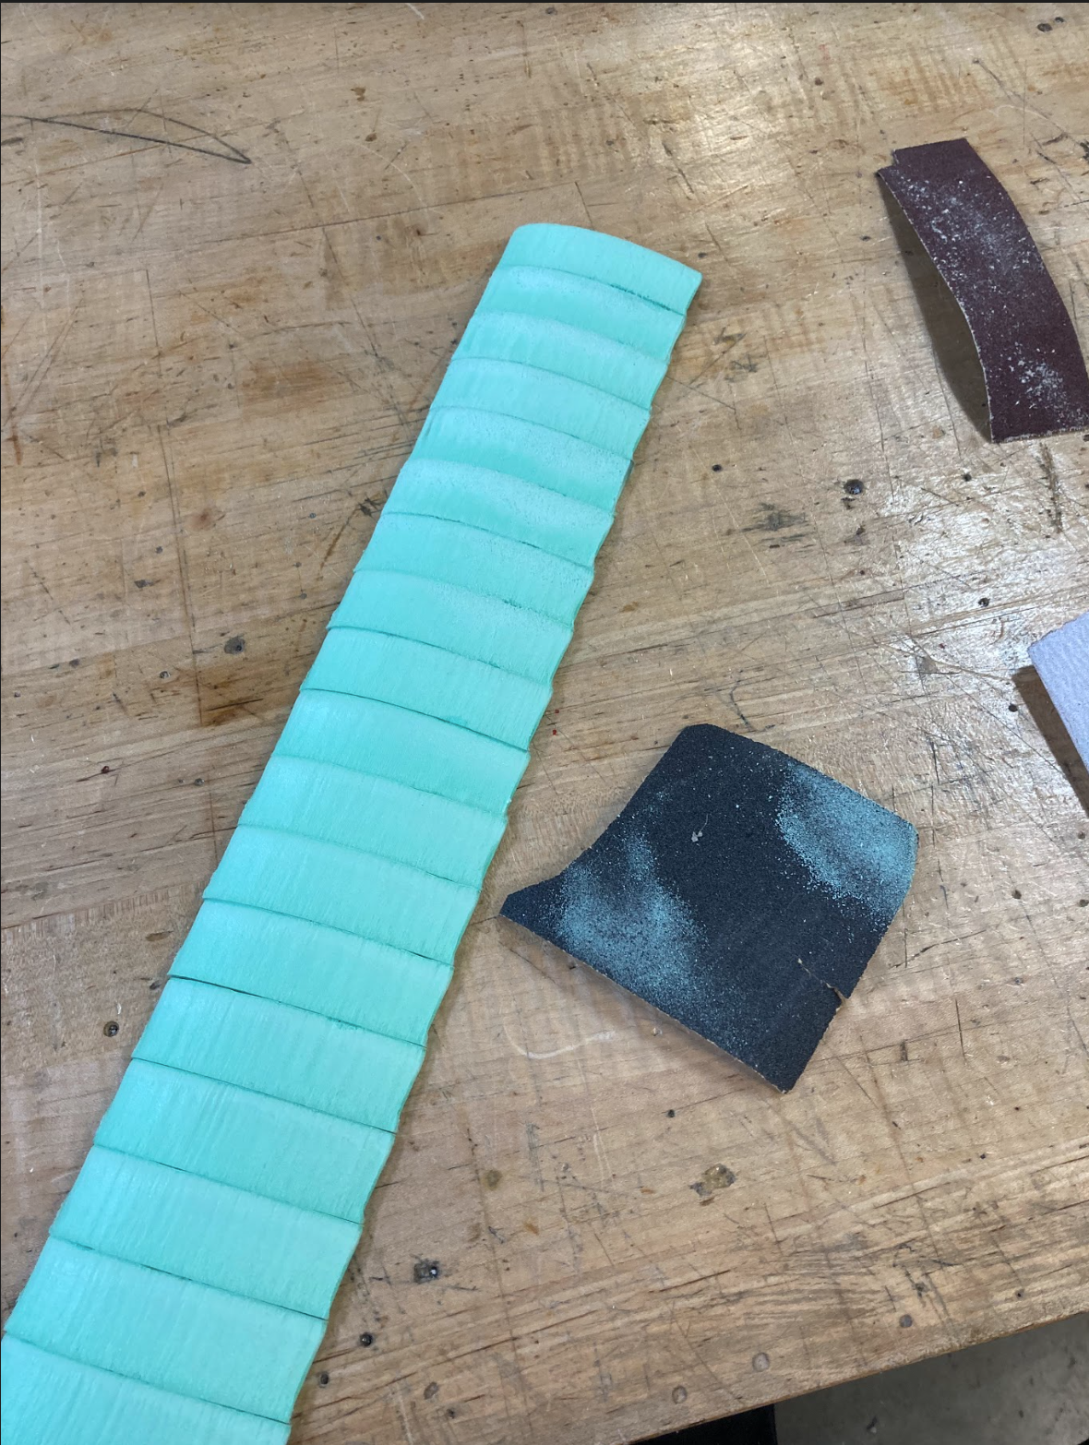
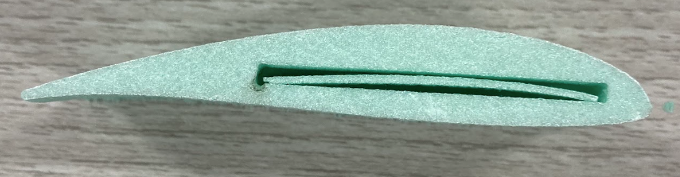
Building the Wings
Failed attempt from a vendor
Getting creative
Laser cut foam board sections on a balsa wood core, wrapped in Monokote

Slide 11
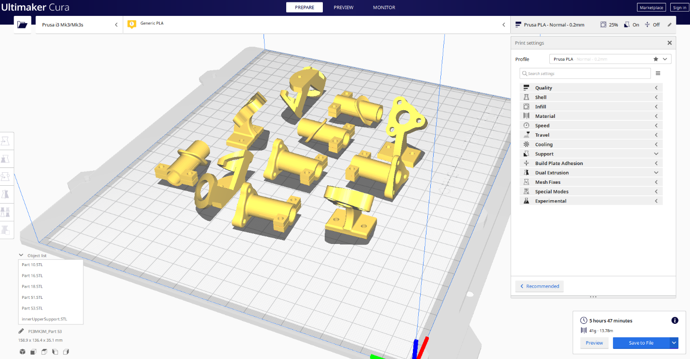
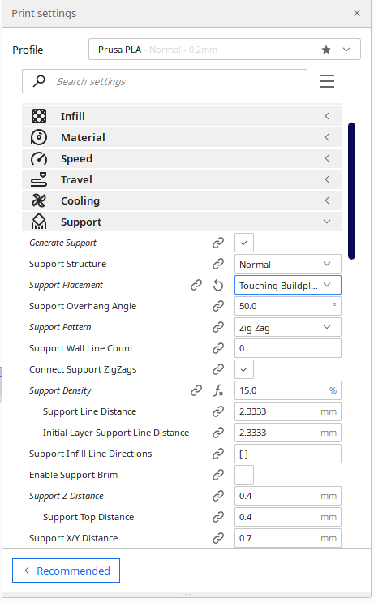
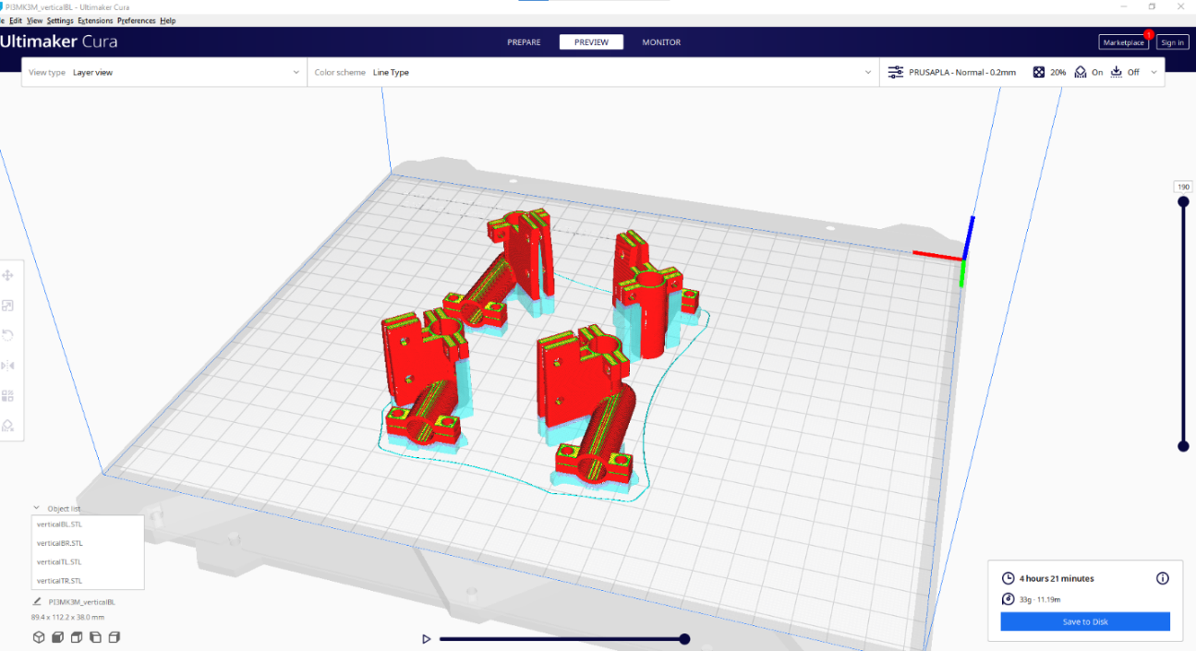
3D Printing
Body and attaching
brackets
Testing Support
Structures
Printing and reprinting
…and reprinting

Slide 12
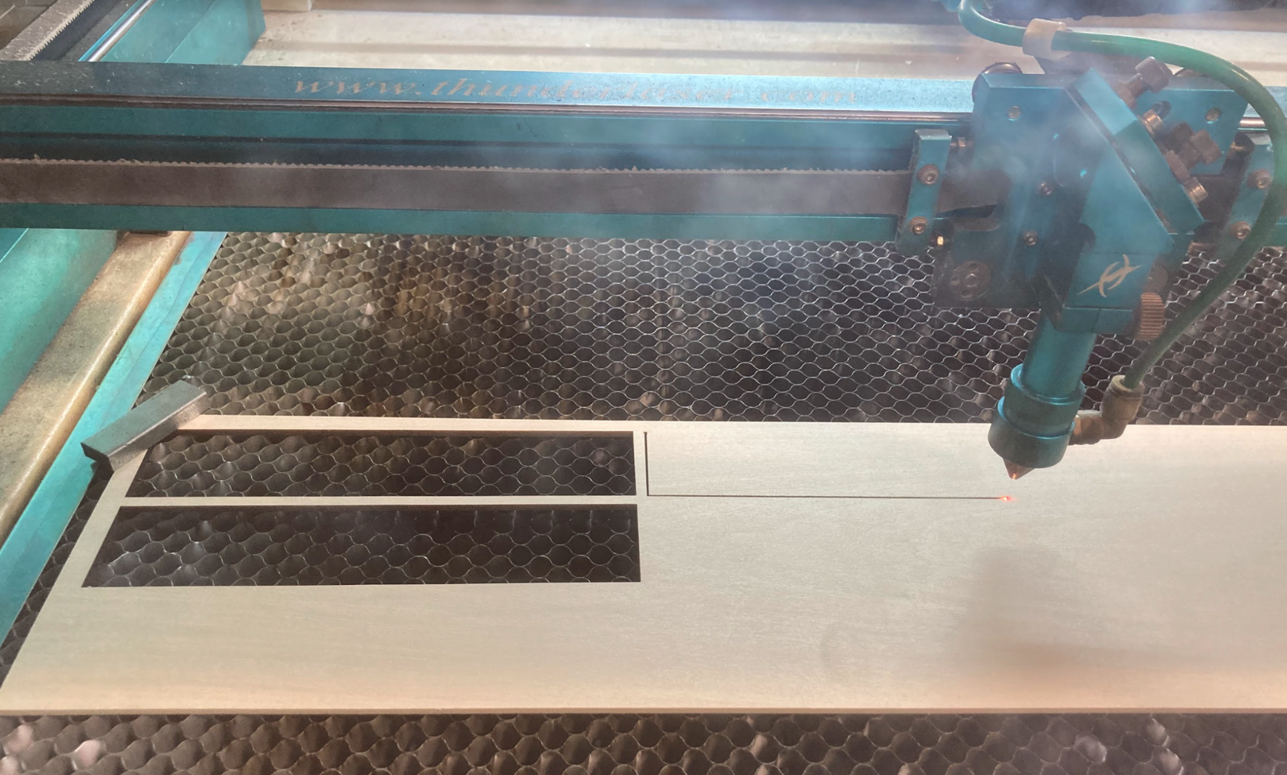
Additional Fabrication
Laser Cut Support Boards
Cutting Carbon Fiber Struts
Drilling out 3D printed brackets
Rough process, many broken parts

Slide 13
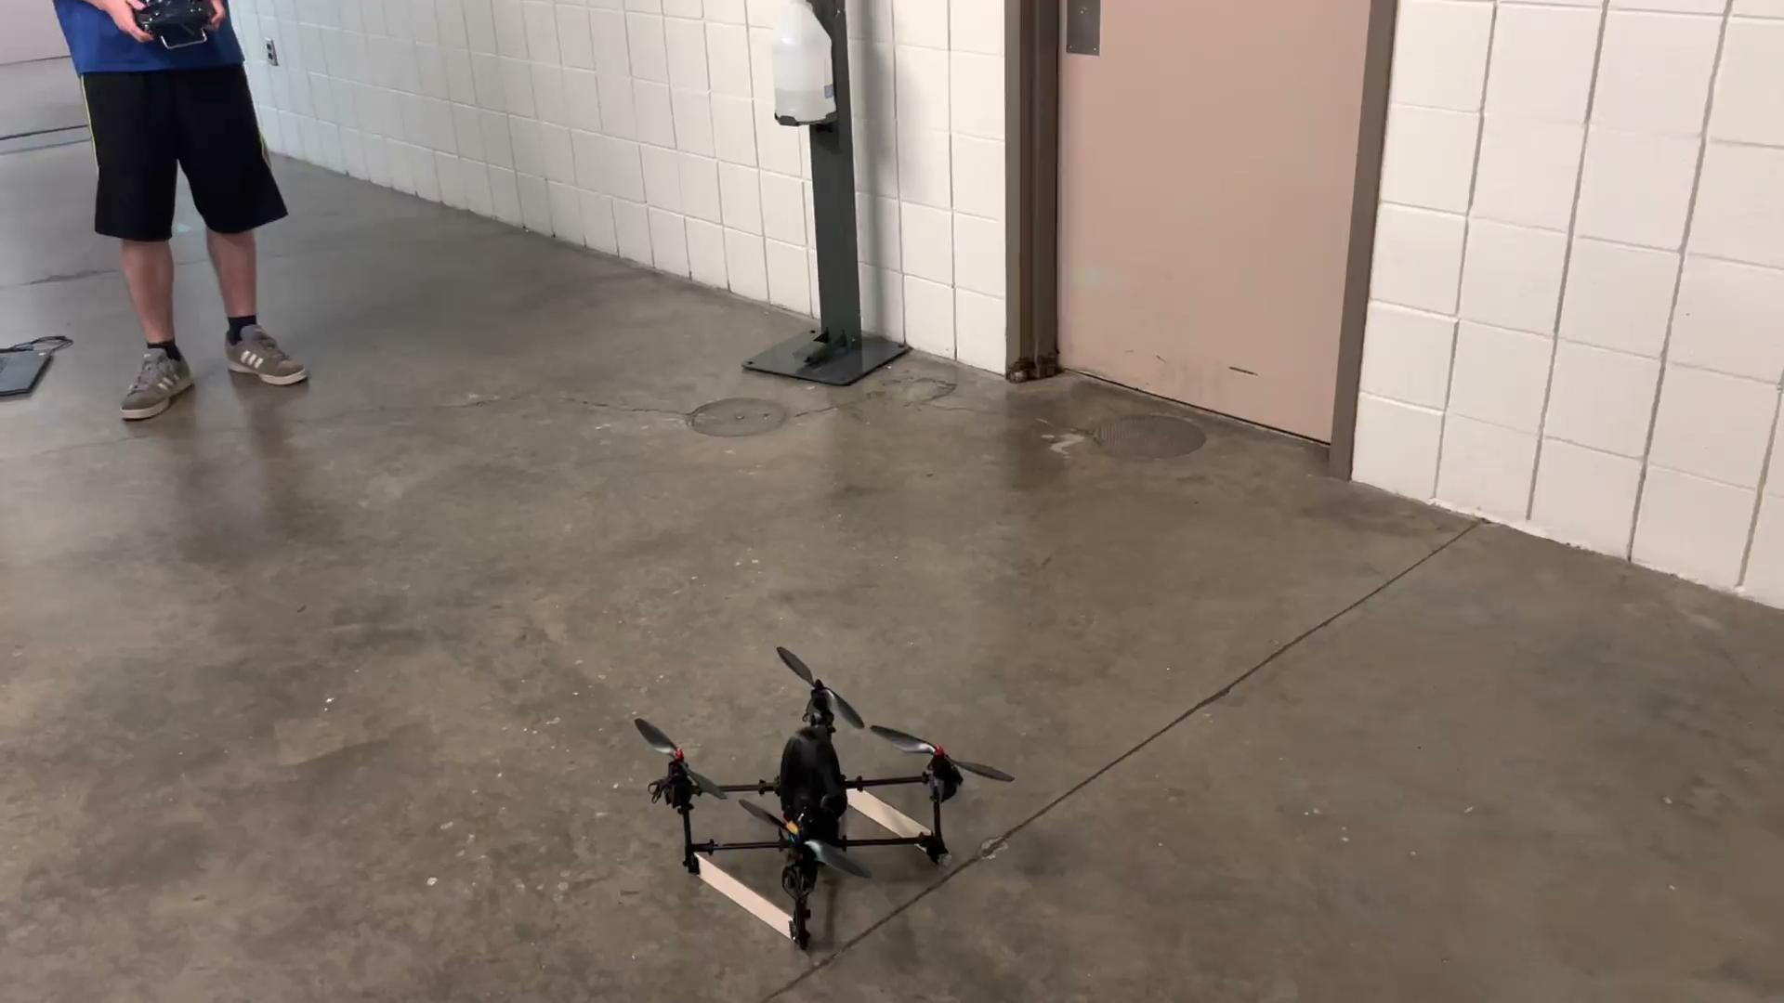
Problems
3D Printing
Failed Prints
Parts breaking easily
Best layering = worst supports
Firmware
Attempting to flash the ARL firmware onto the VOXL
Matching firmware and protocol versions between
transmitter and receiver
Build
Slow is smooth, smooth is fast

Slide 14
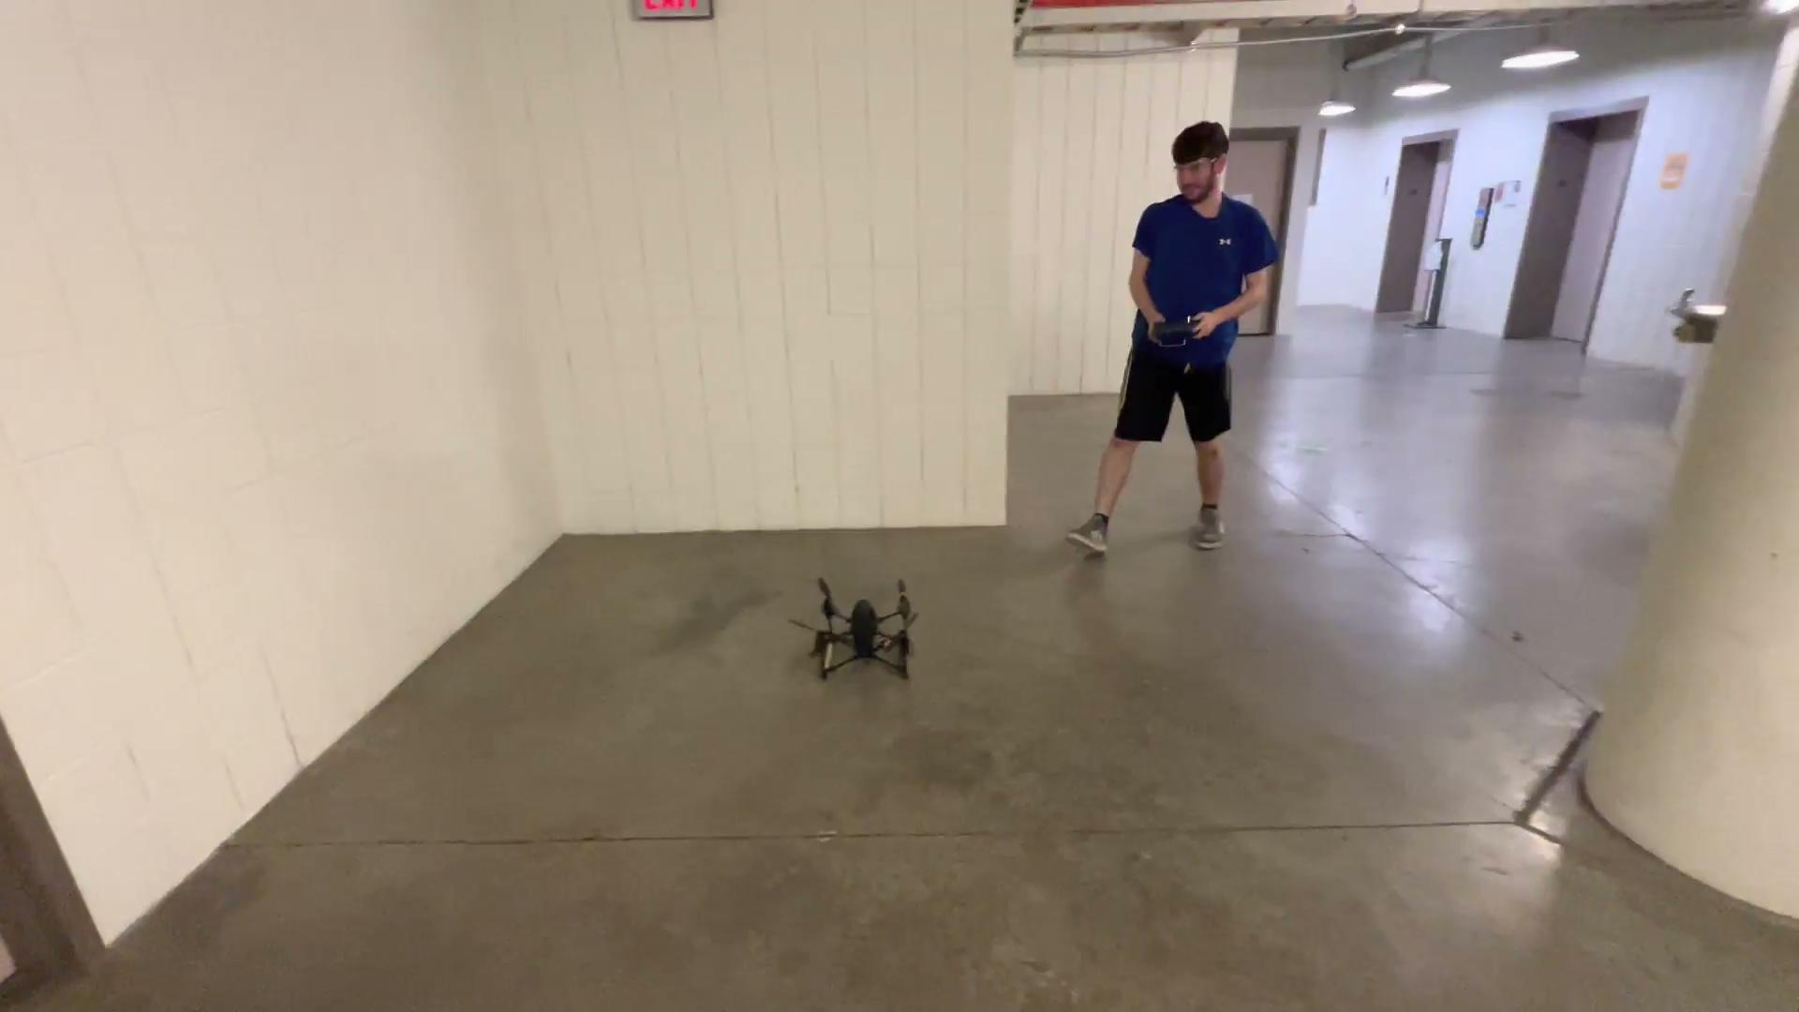
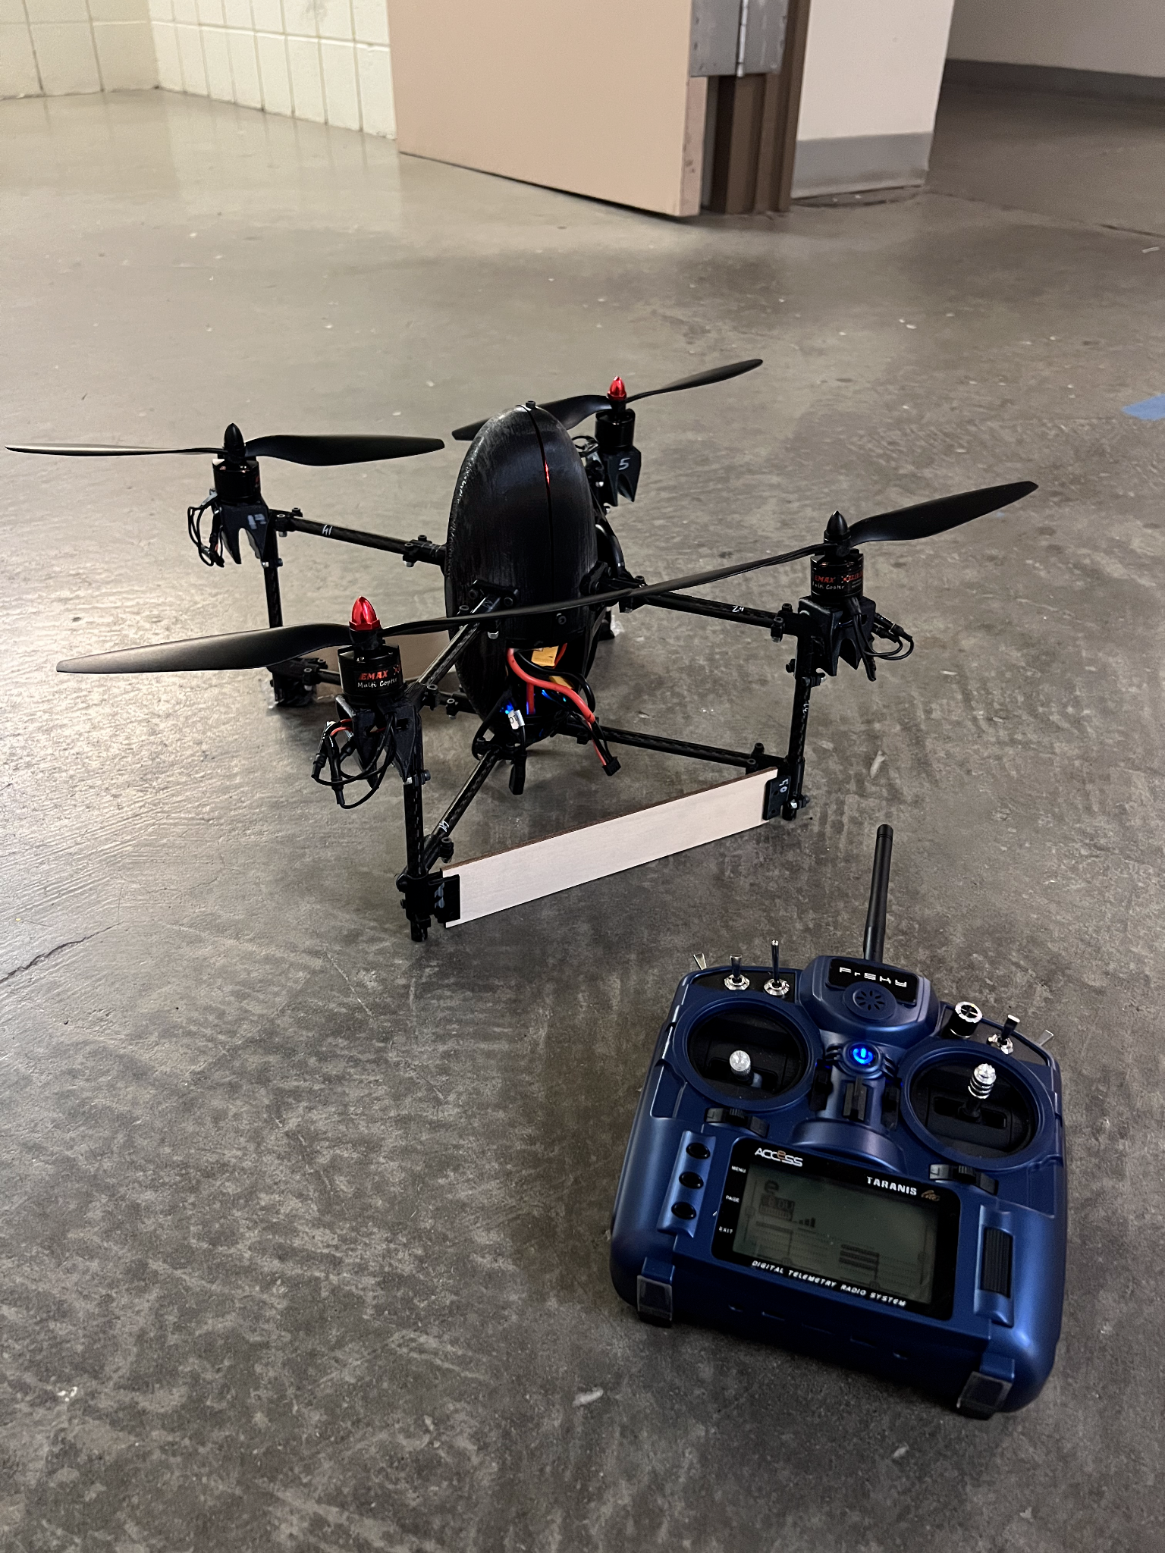
Current State

Slide 15
Future Work
Flight
Tuning parameters in QGC for more controlled hover flight
Basic hovering maneuvers (pitching forward, rolling side to side, controlled landing)
Transition to forward flight
Electronics
Ease of use (on/off switch, electronics jack interface)
Component and cable management
Hardware
Print backups for everything
Purchase additional motors & propellers
Attach the wings, fix the support boards

Slide 16
Questions?
:)

